Slide 1
802.11 Wireless Networks
This document is customized and covers basic wireless information and knowledge for group of users who are very new to wireless technology.

Slide 2
Need for Wireless Networks
Convenience: laptops, mobile phones, smart devices, sensors equipped with the Wi-Fi technology require to connect directly to a wireless LAN.
Mobility: employees can stay connected to the network even when they're not at their desks; people in meetings can access documents and applications; salespeople can check the network for important details from any location; different smart devices provide different smart data or services;
Ease of setup: When you don't have to run physical cables through a location, installation can be quick and cost-effective. Wireless LANs also make it easier to bring network connectivity to hard-to-reach locations, such as a warehouse or factory floor, place without cable infrastructure
Scalability: As your business operations grow, you may need to quickly expand your network. Wireless networks can typically expand with existing equipment, while a wired network might require additional wiring.
Security: Controlling and managing access to your wireless network is important to its success. Advances in Wi-Fi technology provide robust security protections so your data is easily available to only the people you allow access.
Cost: It can cost less to operate a wireless LAN, which eliminates or reduces wiring costs during office moves, reconfigurations, or expansions.

Slide 3
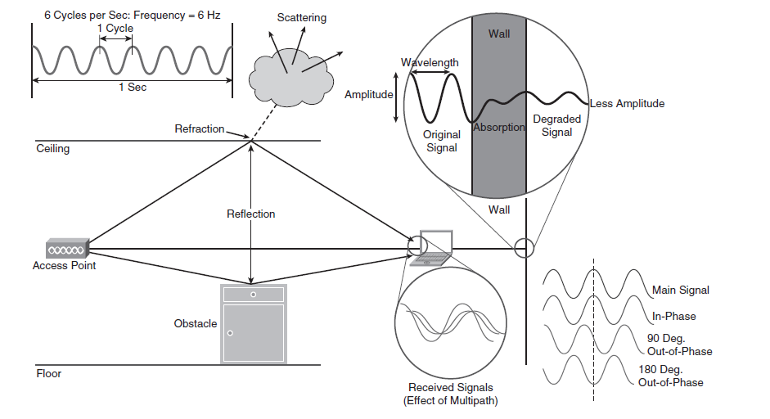
Wireless Fundamentals
RF signals
  EM wave propagation
    Amplitude (RF power, dB)
    frequency
    wavelength
    phase
    reflection
    refraction
    scattering
    multipath
    absorbtion

Slide 4

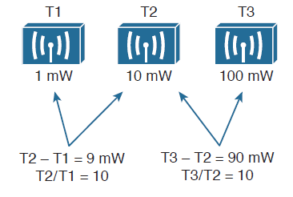
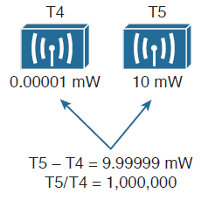
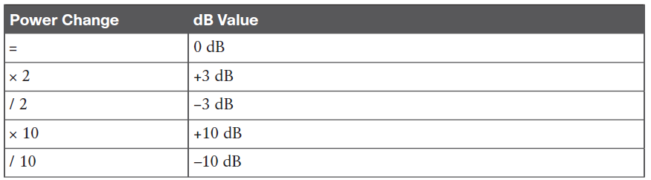
Wireless Fundamentals
RF power vs. dB

Slide 5
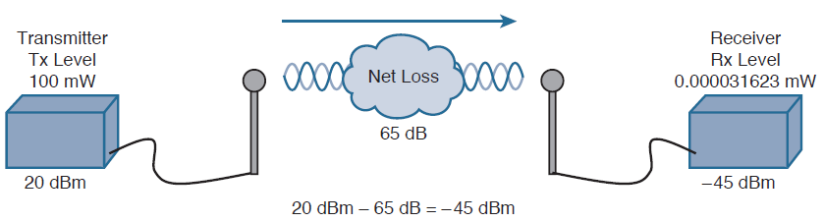

Wireless Fundamentals
Free Path Loss: Even without obstacles, a radio wave gets weaker as it moves away from the emitting source because the energy of the wave spreads
RSSI: Because the RF wave might have been affected by obstacles in its path, it is important to determine how much signal is received by the other endpoint. The value that indicates the amount of power received is called Received Signal Strength Indicator (RSSI).

Slide 6
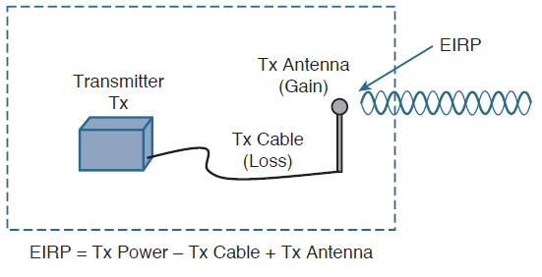
Wireless Fundamentals
EIRP - effective isotropic radiated power
  actual power level radiated from the antenna
  Important parameter regulated by the governmental agencies (FCC, ETSI)
  Tx Power = 10dBm (10mW)
  Cable loss = 5dB
  Antenna gain = 8dBi
  EIRP = 10dBm – 5dB + 8dBi = 13dBm

Slide 7
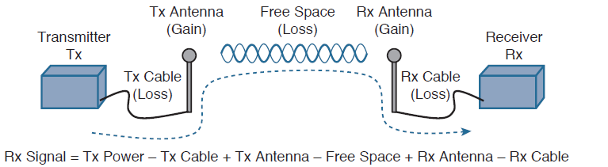
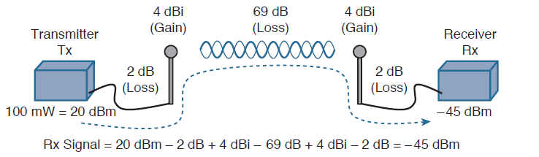
Wireless Fundamentals
Link budget – complete signal path from the transmitter to receiver with its gains and losses

Slide 8
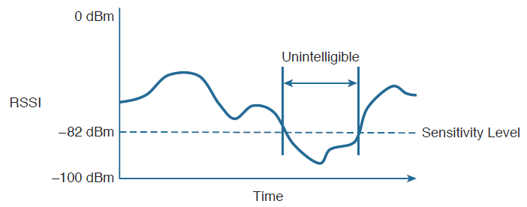
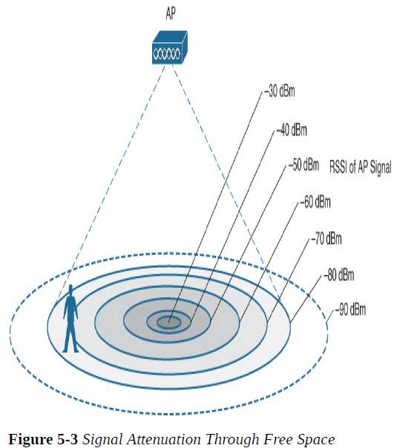
Wireless Fundamentals
Understanding Power Levels at the Receiver
  EIRP ranges normally from 100mW (20dBm) to 1mW (0dBm)
  RSSI ranges usually from 1mW (0dBm) down to 0mW (less than -100dBm)
  Every receiver has a sensitivity level or threshold that divides intelligible, useful signals from unintelligible

Slide 9
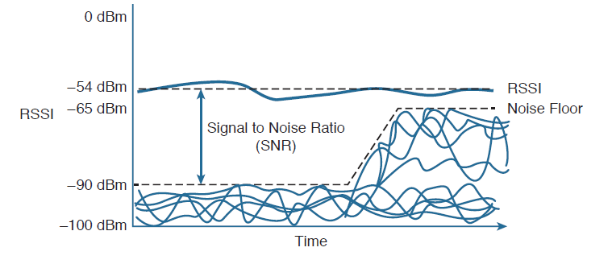
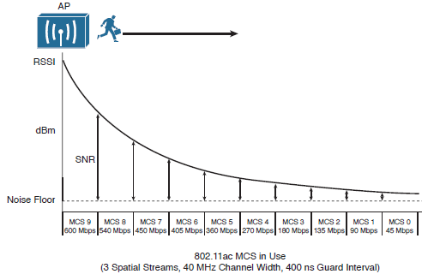
Wireless Fundamentals
SNR – signal to noise ratio
  Higher SNR level is prefferred

Slide 10

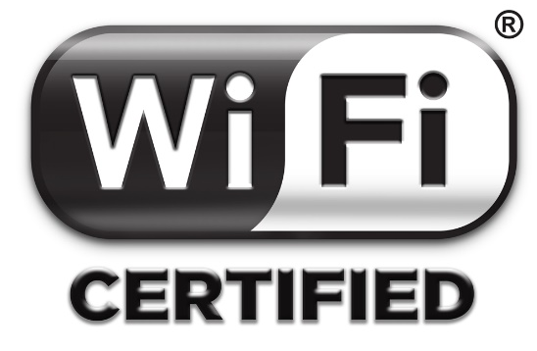
Regulatory Bodies
ITU-R – International Telecommunication Union Regulatory
  provide a hierarchy to manage RF spectrum globally
FCC – Federal communications commission
  restricts the power and the frequency used in the region
ETSI – European Telecommunication Standards Institute
  controls frequency and power in Europe and other countries like Israel and some other countries
IEEE – Institute of Electrical and Electronics Engineers
  creates and maintains technical standards and protocols used
  802 standards deals with LAN/MAN
  802.11 standard deals with WLAN
Wi-Fi Aliance
  ensures that wireless products available to consumers are tested and provide the features that are compatible and interoperable to other Wi-Fi certified products

Slide 11
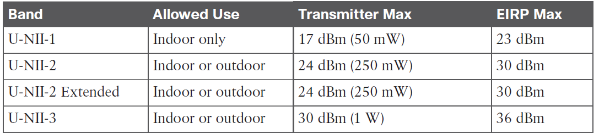
Regulatory Bodies
FCC

Slide 12
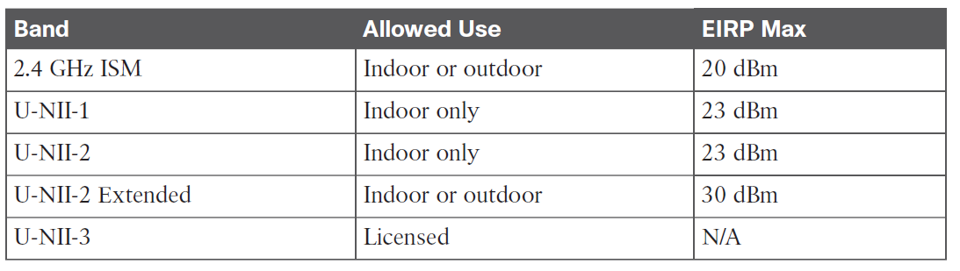
Regulatory Bodies
ETSI

Slide 13
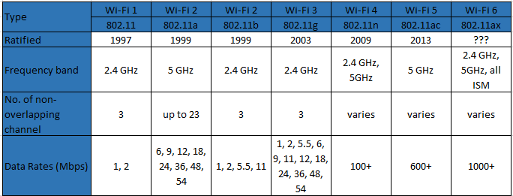
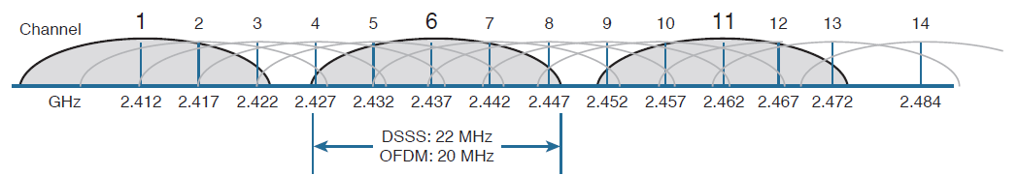
Wireless Network Types (Standards)

Slide 14
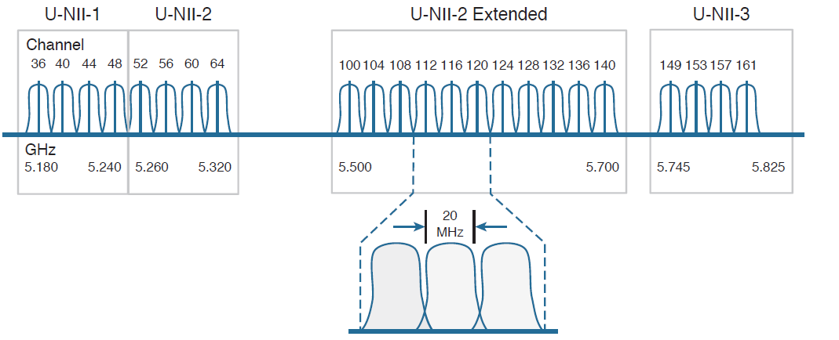
Wireless Network Types (Standards)

Slide 15
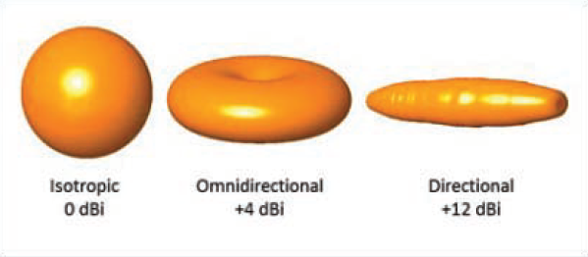
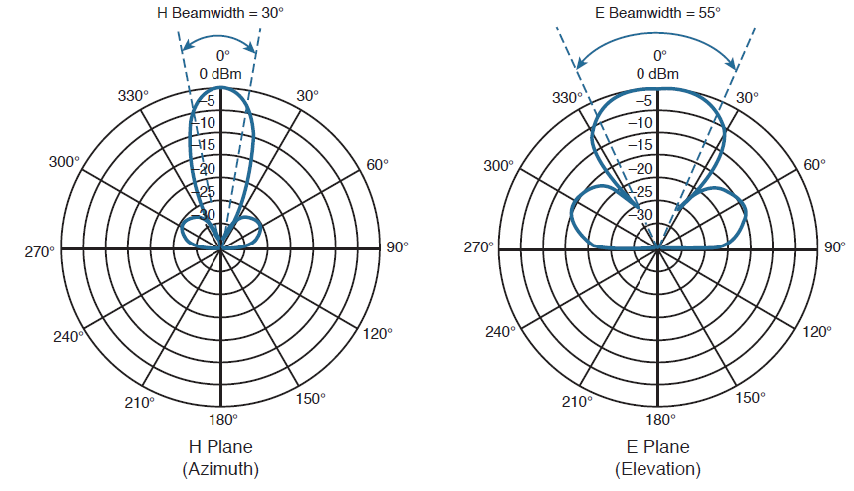
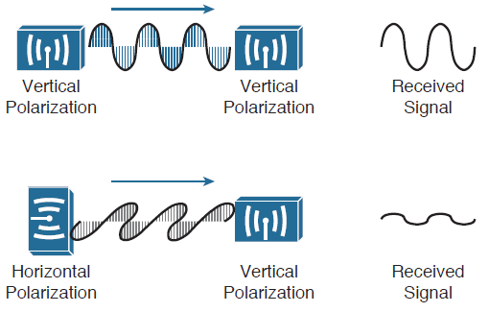
Antenna Characteristics
Radiation pattern
Gain
Beamwidth
Polarization
Antenna types

Slide 16
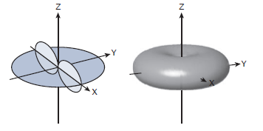
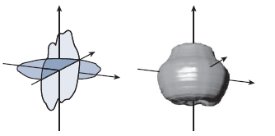
Antenna Types
Omnidirectional (usually built-in dipole antennas)
    ideal cisco AP built-in

Slide 17
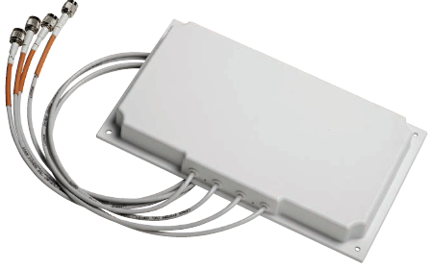
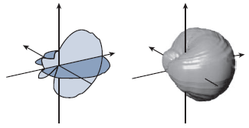
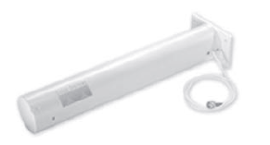
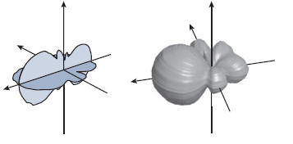
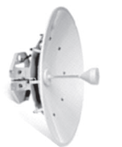
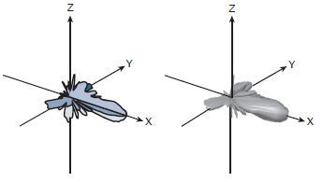
Antenna Types
Directional
  Patch
  Yagi
  Dish

Slide 18
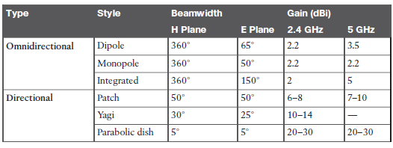
Antenna Types

Slide 19
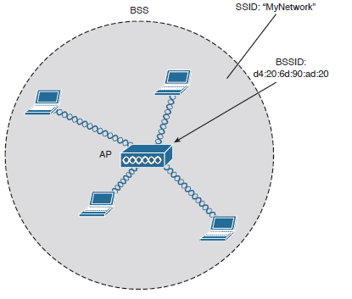
Wireless LAN topologies
BSS (Basic Service Set) – group of wireless stations formed around the AP
BSA (Basic Service Area) – wireless cell created around the AP
BSSID – MAC address of AP wireless radio

Slide 20
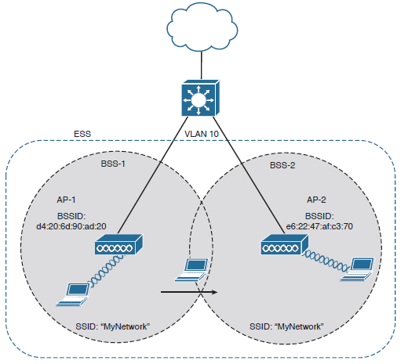
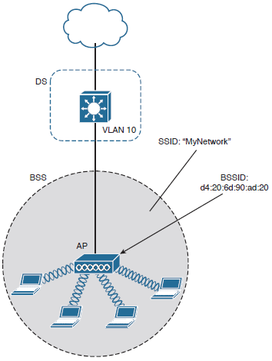
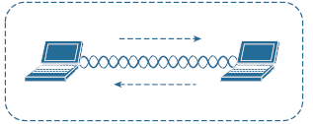
Wireless LAN topologies
IBSS – Independent Basic Service Set – Ad-Hoc Wireless Network - Wireless network created by a stations without APs
DS - Distribution System - The wired section of the network that can be reached through the AP
ESS – Extended Service Set - links two or more APs to one group and allows mobility roaming of wireless devices within a distributed system.
Distribution System
Extended Service Set
Independent BSS

Slide 21
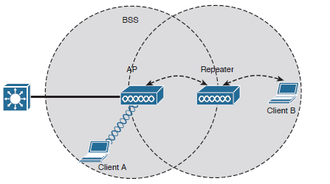
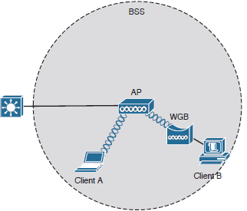
Wireless LAN topologies
Repeater
  Extends the AP coverage
  Dual radio can create dual half-duplex
  Overlap of 50% required
  Throughput impacted when single frequency used
Workgroup Bridge
  A WGB provides wireless connection from Ethernet port.
  Several devices can benefit if the WGB is connected to a switch.

Slide 22
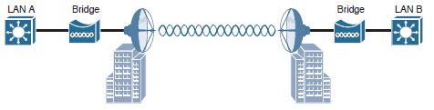
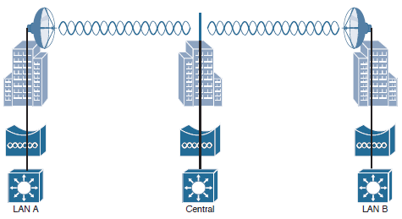
Wireless LAN topologies
Outdoor Wireless Bridge
  Extend the LAN by linking LANs
  Usually a few miles range
  Point to point or hub and spoke

Slide 23
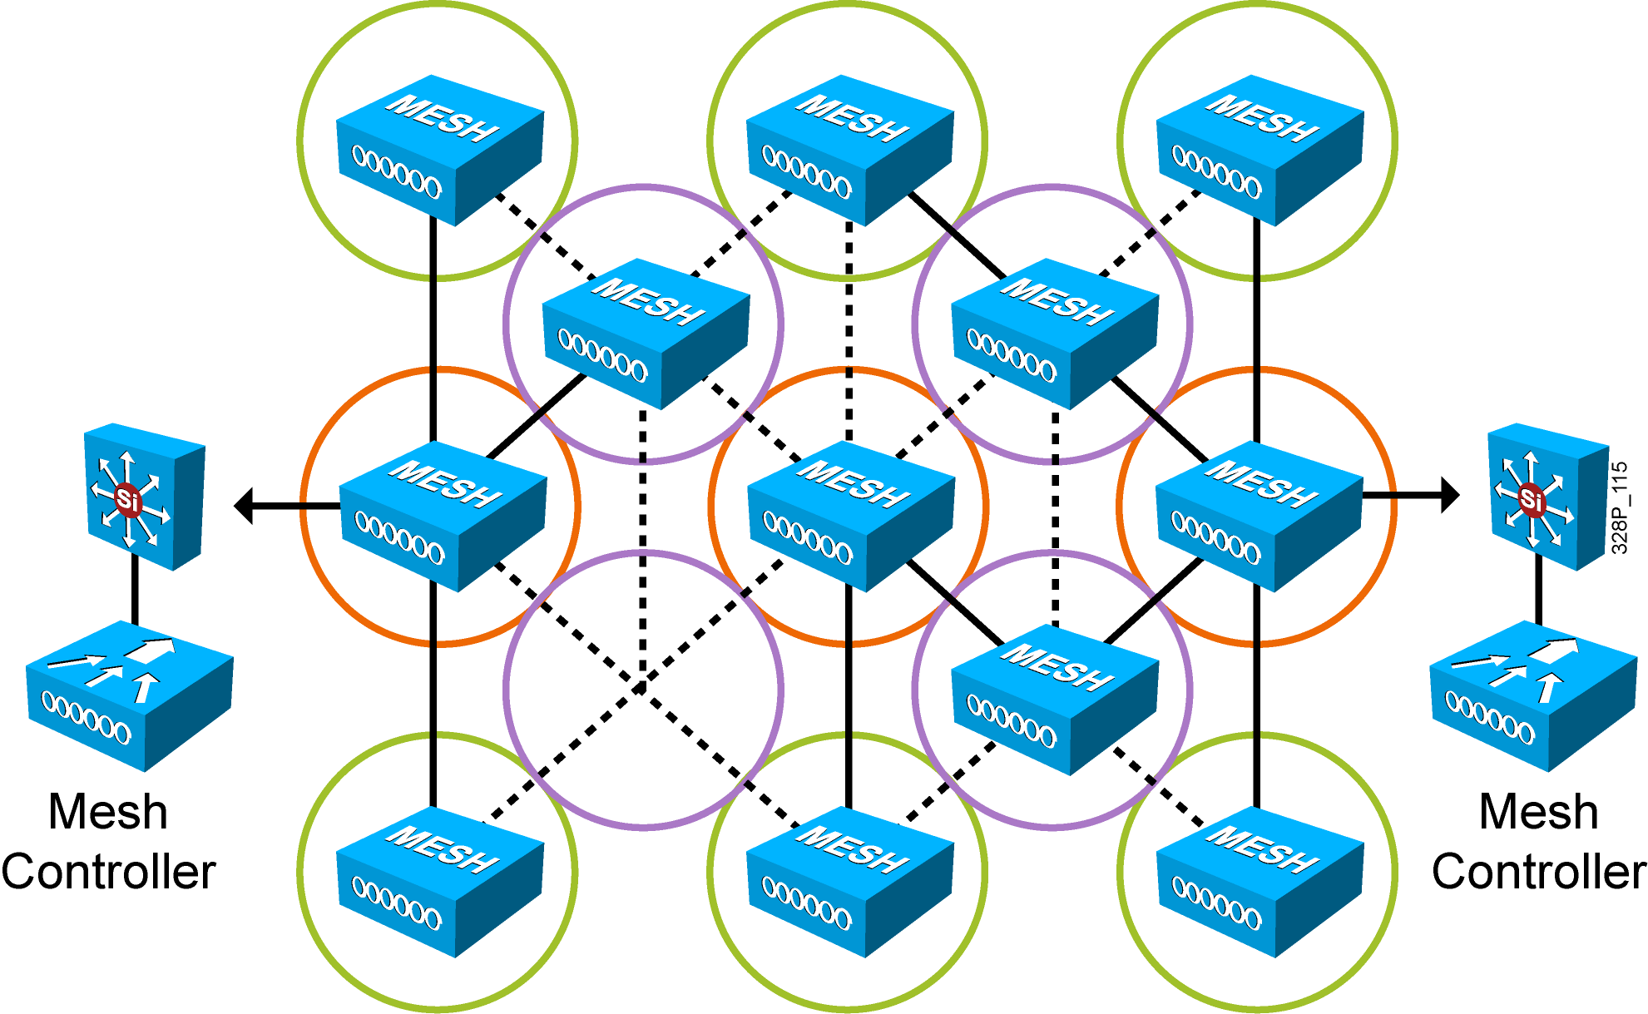
Wireless LAN Topologies
Mesh Networks
  provide wireless coverage over a large area
  devices are connected with redundant connection between nodes
  no single point of failure
  usually 5GHz radio is a backbone
  2.4GHz radio serve as BSS
  RAP (root AP – connected by Ethernet cable)
  MAP (Mesh AP – connected wirelessly)

Slide 24
Wireless Network Standards features
802.11n
  introduce channel aggregation (2 adjacent 20-MHz channels are combined to create a single 40-MHz channel)
  MAC aggregation packs smaller packets into a single unit
  Block acknowledgment improves throughput
  Maximal Ratio Combining (MRC)
  Transmit Beamforming
  Spatial multiplexing
802.11ac
  5 GHz operation only
  up to 8 spatial streams
  introduce up to 160 MHz channel
  256-QAM modulation
  wave 2 introduce MU-MIMO
802.11ax
  introduce OFDMA - Orthogonal Frequency-Division Multiple Access
  Spatial frequency reuse (device coloring to differentiate own and neighboring devices)
  1024-QAM modulation
  TWT – Target Wake Time
  WPA3

Slide 25
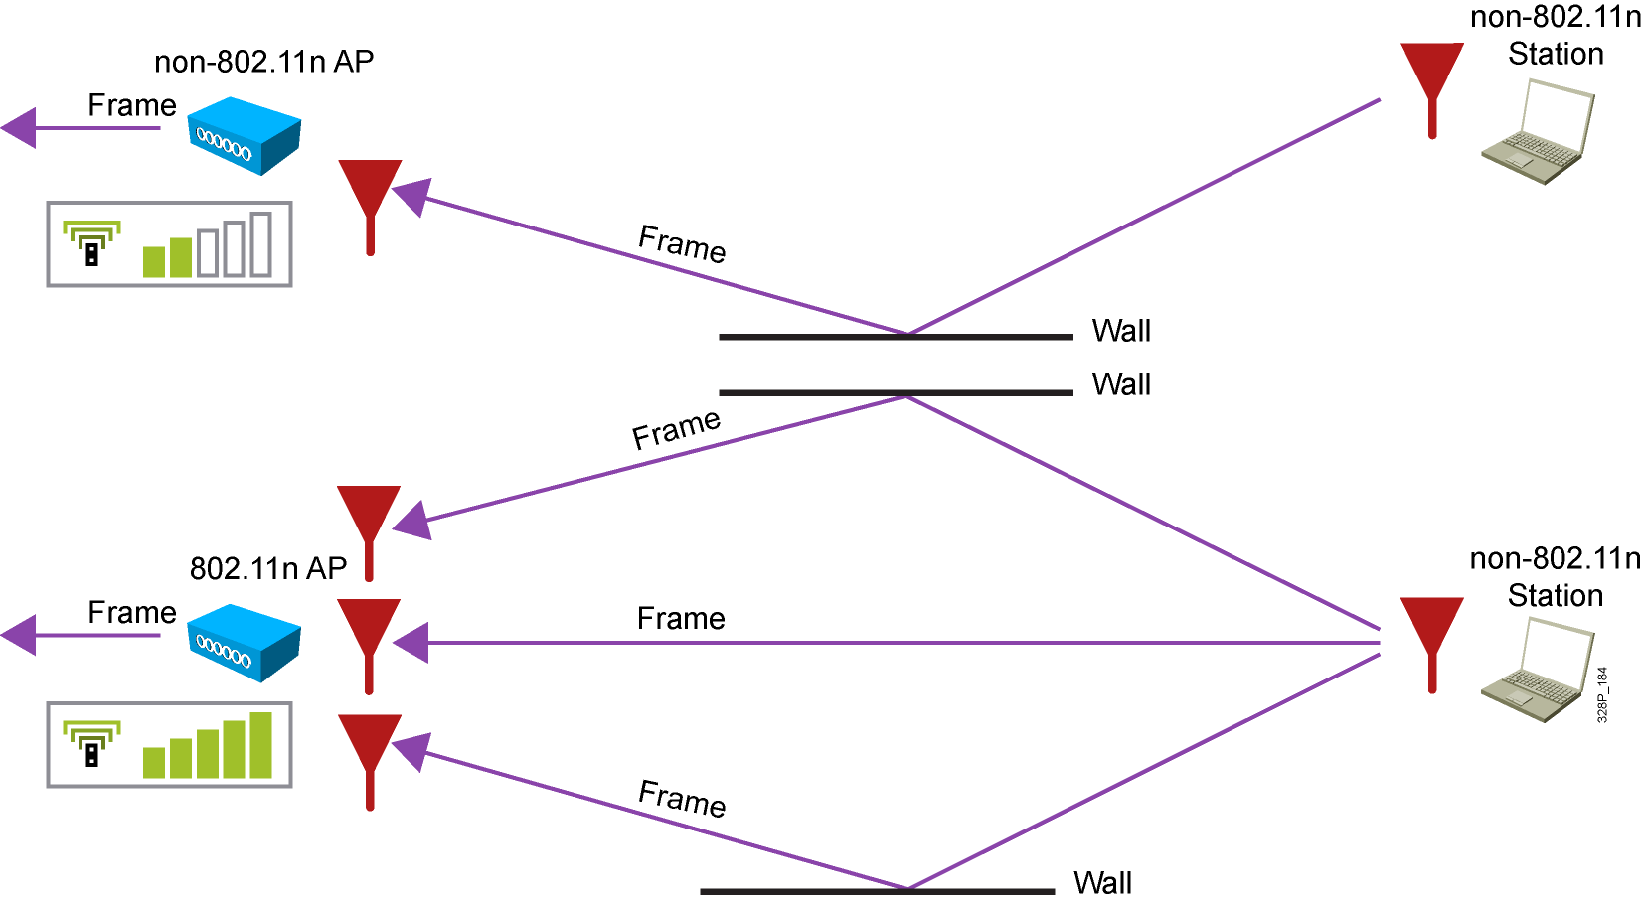
Wireless Network Standards features
MRC (Maximal Ratio Combining )
  is used by the receiver with multiple antennas to optimally combine energies from multiple receive chains. An algorithm eliminates out-of-phase signal degradation

Slide 26
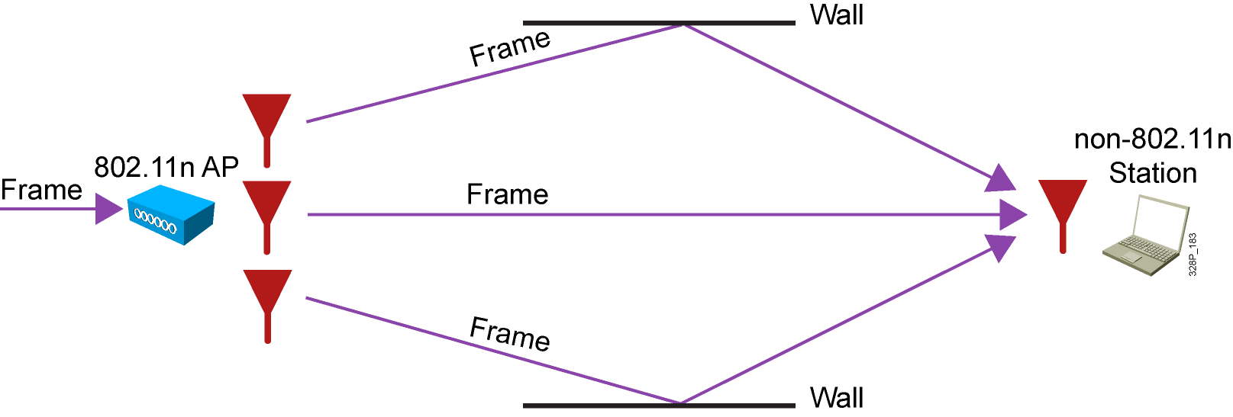
Wireless Network Standards features
Transmit Beamforming (TxBF)
  The emitter can send the same signal from several antennas. By carefully coordinating these signals based on the feedback transmitted by the 802.11n receiving station, the emitter aims at making these signals be received in phase, thus increasing the signal power level at the receiving station, allowing for longer range or higher throughput

Slide 27
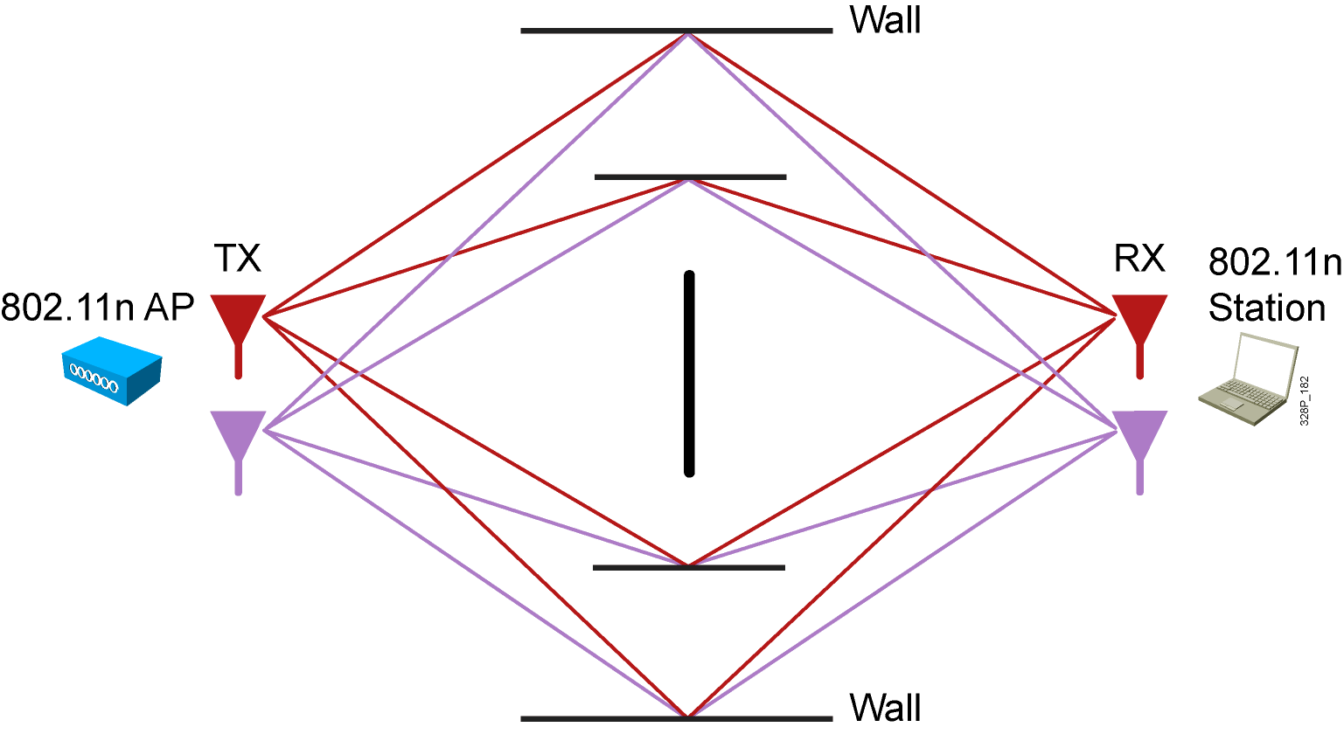
Wireless Network Standards features
Spatial multiplexing
  The emitter can send different simultaneous signals from different radios. The 802.11n receiver will receive these signals on all its radios. Each of the receive radios independently decode the arriving signals. Then, each receive signal is combined with the signals from the other radios. This results in additional throughput

Slide 28
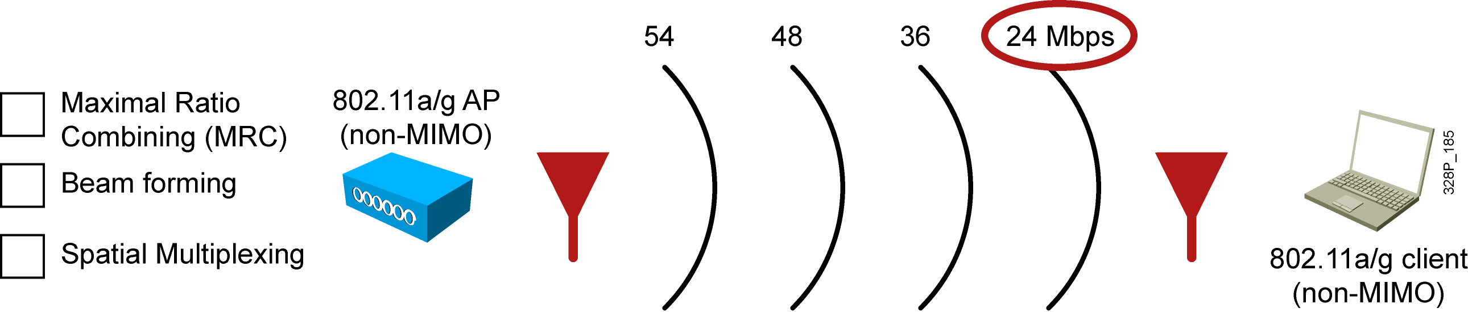
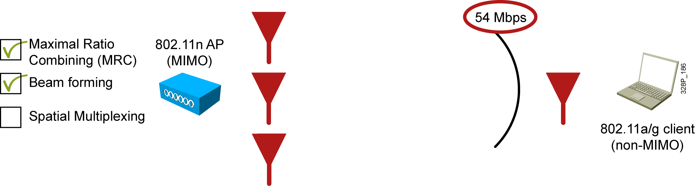
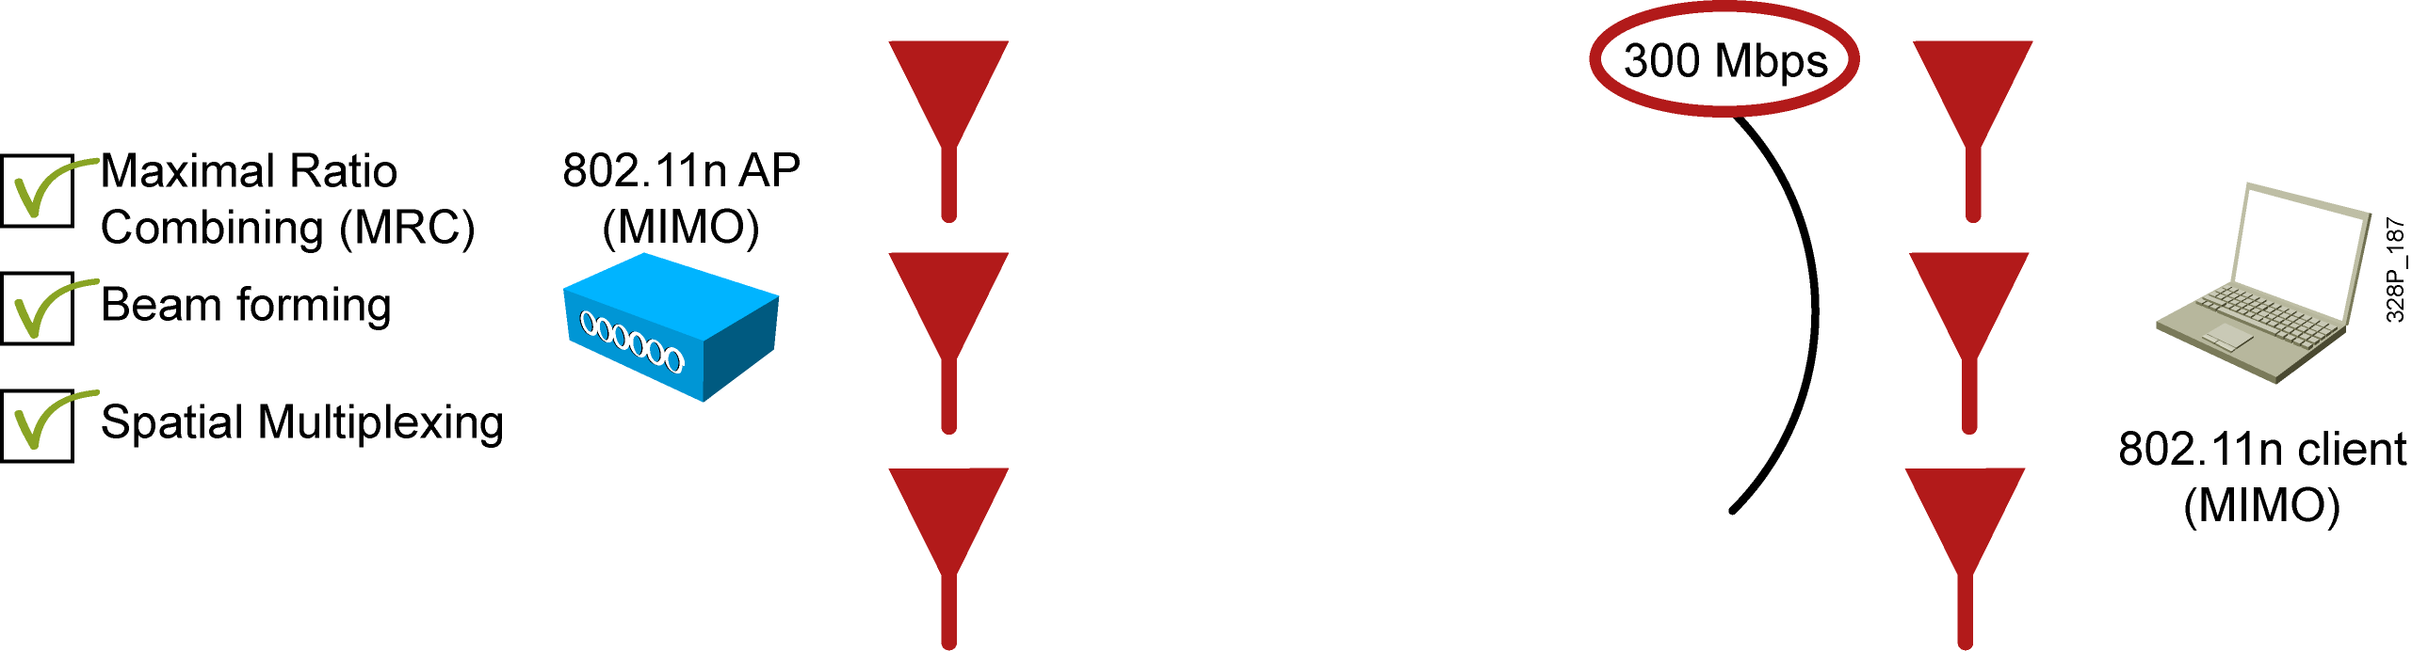
Wireless Network Standards features
MIMO Benefits

Slide 29
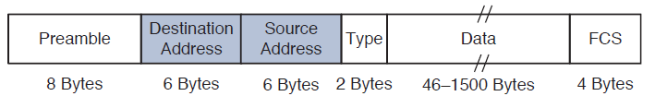
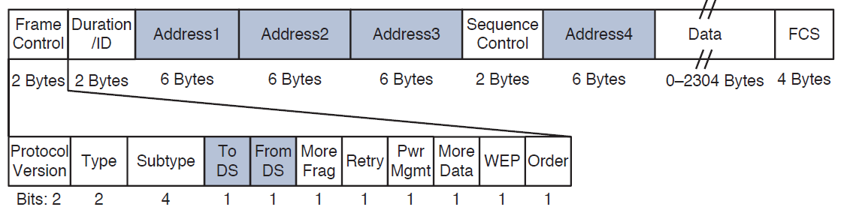
802.11 Frame and CSMA/CA
802.3 Frame
DS – Distribution System
FCS – Frame Check Sequence
Type – Data, Control, Management
Address1 – Receiving Address (RA)
Address2 – Transmitting Address (TA)
Address3 – Source/Dest. Address (SA/DA)
Address4 – SA (mesh,WGB)
802.11 Frame

Slide 30
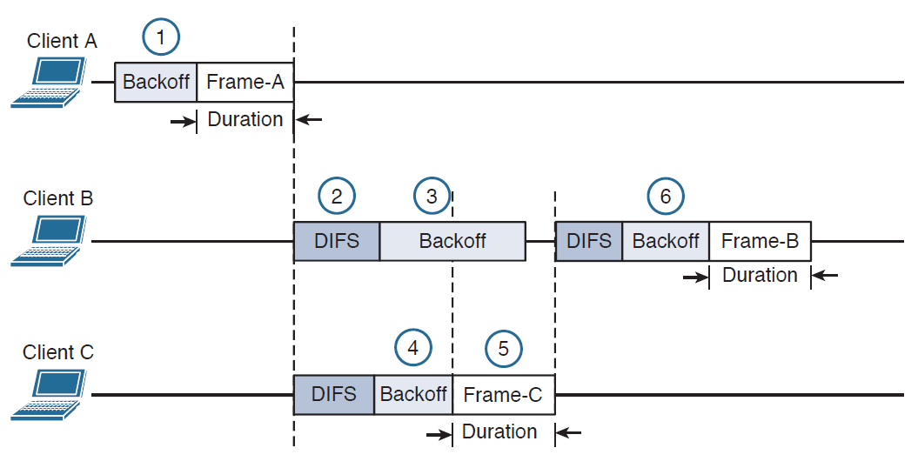
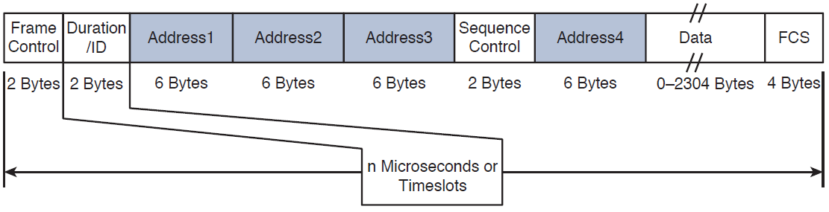
802.11 Frame and CSMA/CA
CSMA/CA example
CSMA/CA – Carrier Sence Multiple Access / Collision Avoidance
Backoff timer – contention window (0-31 slots)
DIFS – distributed interframe space
FRAME (in the example) = DATA + SIFS + ACK

Slide 31
802.11 Frame and CSMA/CA
Frame Types
  Data frames
  Control frame
    RTS (request to send)
    CTS (clear to send)
    ACK (acknowledgement)
  Management frame
    Beacon
    Probe request/response
    Authentication/Deauthentication
    Association Request/Response, Reassociation Request/Response, Disassociation

Slide 32
Cisco Wireless Network Architecture
Autonomous architecture
  Autonomous APs, access switches, distribution switches
  offering one or more fully functional standalone BSSs
  different SSIDs are linked to different VLANs
  each AP must be configured locally
Controller based (split-MAC) architecture
  Lightweight APs (LAPs) are centrally managed and configured by the WLC
  Wireless LAN Controller (WLC) performs
    RF management
    association and roaming management
    client authentication
    management of security policies
    QoS
  LAP itself performs real-time 802.11 interaction
    RF Transmit/Receive of Data
    Data Encryption
  2 CAPWAP (Control and Provisioning of Wireless AP) tunnels are created btw. WLC and LAPs
    CAPWAP control messages (encrypted and authenticated) transported over 5246 UDP port
    CAPWAP data (not encrypted by default) transported over the 5247 UDP

Slide 33
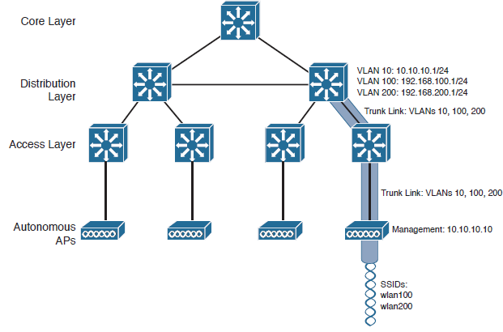
Autonomous Architecture

Slide 34


Controller-based Architecture

Slide 35



Wireless LAN Controller Models
Small size WLC
  2504/3504 (75/150 APs, 1000/3000 clients)
Middle size WLC
  Virtual WLC, 5508, 5520, WiSM2 (200-1500 APs, 6000-20000 clients)
Enterprise WLC
  8510, 8540 (6000 APs, 64000 clients)

Slide 36



Access Point models
Indoor (802.11ac models)
  1700/1800 series
  2700/2800 series
  3700/3800 series
  4800 series
Outdoor
  1530/1540/1552/1560/1570 series
Catalyst 91xx series
  Wi-Fi 6 models

Slide 37
Client mobility (Roaming)
WLAN clients expect
  good, seamless coverage whenever go
Clients know how to roam and ignore WLAN infrastructure
  have their own algorithms for roaming, own written driver
Clean roaming requires
  Neighboring APs should use different non-overlapping channels
  Cell coverage overlap is usually 15% - 20% for voice service (cisco advice)
  Cell coverage overlap is usually 10% - 15% for most data apps (cisco advice)
Client undergo
  re-association
  DHCP renew
  re-authentication
  Cisco WLCs utilize following features to eliminate the complete process of re-association, DHCP renew and re-authentication
    CCKM (Cisco Centralised Key Management) – WLC keeps DBs of clients and keys to share with other WLCs in case of roaming, this feature requires CCX (Cisco Compatible Extentions) on the client to operate correctly
    Key Caching – each client keeps the list of keys used with prior AP associations (limited to 8 AP-key entries)
    802.11r (fast roaming, fast BSS transitions) – client can cache a portion of the authentication server’s key and present that to future APs as it roams
Roaming btw. autonomous APs
Intracontroller roaming
Intercontroller roaming
  must use the same Mobility Group for seamless roaming

Slide 38


Client mobility (Roaming)
Autonomous AP’s client roaming

Slide 39


Client mobility (Roaming)
Intracontroller roaming

Slide 40


Client mobility (Roaming)
Intercontroller roaming L2

Slide 41


Client mobility (Roaming)
Intercontroller roaming L3

Slide 42
Wireless LAN Security
Anatomy of secure connection -> TRUST, PRIVACY, INTEGRITY
TRUST -> Authentication (provide credentials)
PRIVACY -> Encryption
INTEGRITY -> MIC - Message integrity check - protects against data tampering
Client to join BSS must firstly authenticate (send authentication request frame, AP responds with AUTH response frame).
After successful AUTHentication, client can ASSOCIATE with the BSS (send association frame, AP will reply with ASSOC response frame, along with a unique AID - association ID)
For each client, AP has its own key, so other users cannot decrypt data transferred in between.
AP also has "group key" in case AP needs to inform all clients at once.

Slide 43
Wireless LAN Security
WLAN client authentication methods
  OPEN (client must send AUTH REQ before it associate with the AP, no credentials needed)
  WEP (Wired Equivalent Privacy) - uses RC4 cipher algorithm, is weak, not used these days
  802.1x/EAP (Extensible Authentication Protocol) - when enabled, it allows client to associate with the AP, but don't pass any data to the network until successful authentication.
EAP authentication methods
  LEAP (Lightweight EAP) - cisco proprietary, deprecated
  EAP-FAST (EAP-Flexible Authentication by Secure Tunelling) - cisco proprietary
  PEAP - Protected EAP
  EAP-TLS - EAP Transport Layer Security
    requires certificate on AS (auth server) and each client device
    TLS tunnel is built after authentication
    considered most secure authentication method

Slide 44
Wireless LAN Security
Wireless Privacy and Integrity Methods
  TKIP - Temporal Key Integrity Protocol - deprecated, created to support older WLAN clients (used in WPA1)
  CCMP - Counter/CBC-MAC Protocol - consists of two algorithms
    AES counter mode encryption
    Cipher Block Chaining Message Authentication Code (CBC-MAC) used as a message integrity check
    Used in WPA2
  GCMP – Galois/Counter Mode Protocol
    More secure and more efficient than CCMP, allows higher data throughput than CCMP
    Used in WPA3
    AES counter mode encryption
    GMAC (Galois Message Authentication Code) is used as a MIC to ensure integrity of messages

Slide 45
Wireless LAN Security
The Wi-Fi alliance has developed 3 WPA certifications for Wi-Fi devices
WPA, WPA2, WPA3 – wireless protected access
  WPA3 has also additional features
    PMF (Protected Management Frames) – protects 802.11 mgmt. frame from eavesdropping
    SAE (Simultaneous Authentications of Equals) – protects 4-way handshake when PSK is used
    Forward Secrecy – prevents data decryption after being transmitted over the air
 | WPA | WPA2 | WPA3
Authentication | PSK (personal mode)/802.1x | PSK (personal mode)/802.1x | PSK (personal mode)/802.1x
Encryption and MIC | TKIP / AES (CCMP) | AES (CCMP) | AES (GCMP)
Key Management | Dynamic Key managemet | Dynamic Key managemet | Dynamic Key managemet

